Slide 1

REGULAR MEETING OF THE
ARKANSAS HIGHER EDUCATION
COORDINATING BOARD
July 26, 2024

Slide 2
AHECB Members
Graycen Bigger, Chair
Dr. Jerry Cash, Vice Chair
Dr. Kyle Miller, Secretary
Dr. Jim Carr
Dr. Katherine Dudley
Chad Hooten
Heather Maxey
Lucas Pointer
Carolyn Rhinehart

Slide 3
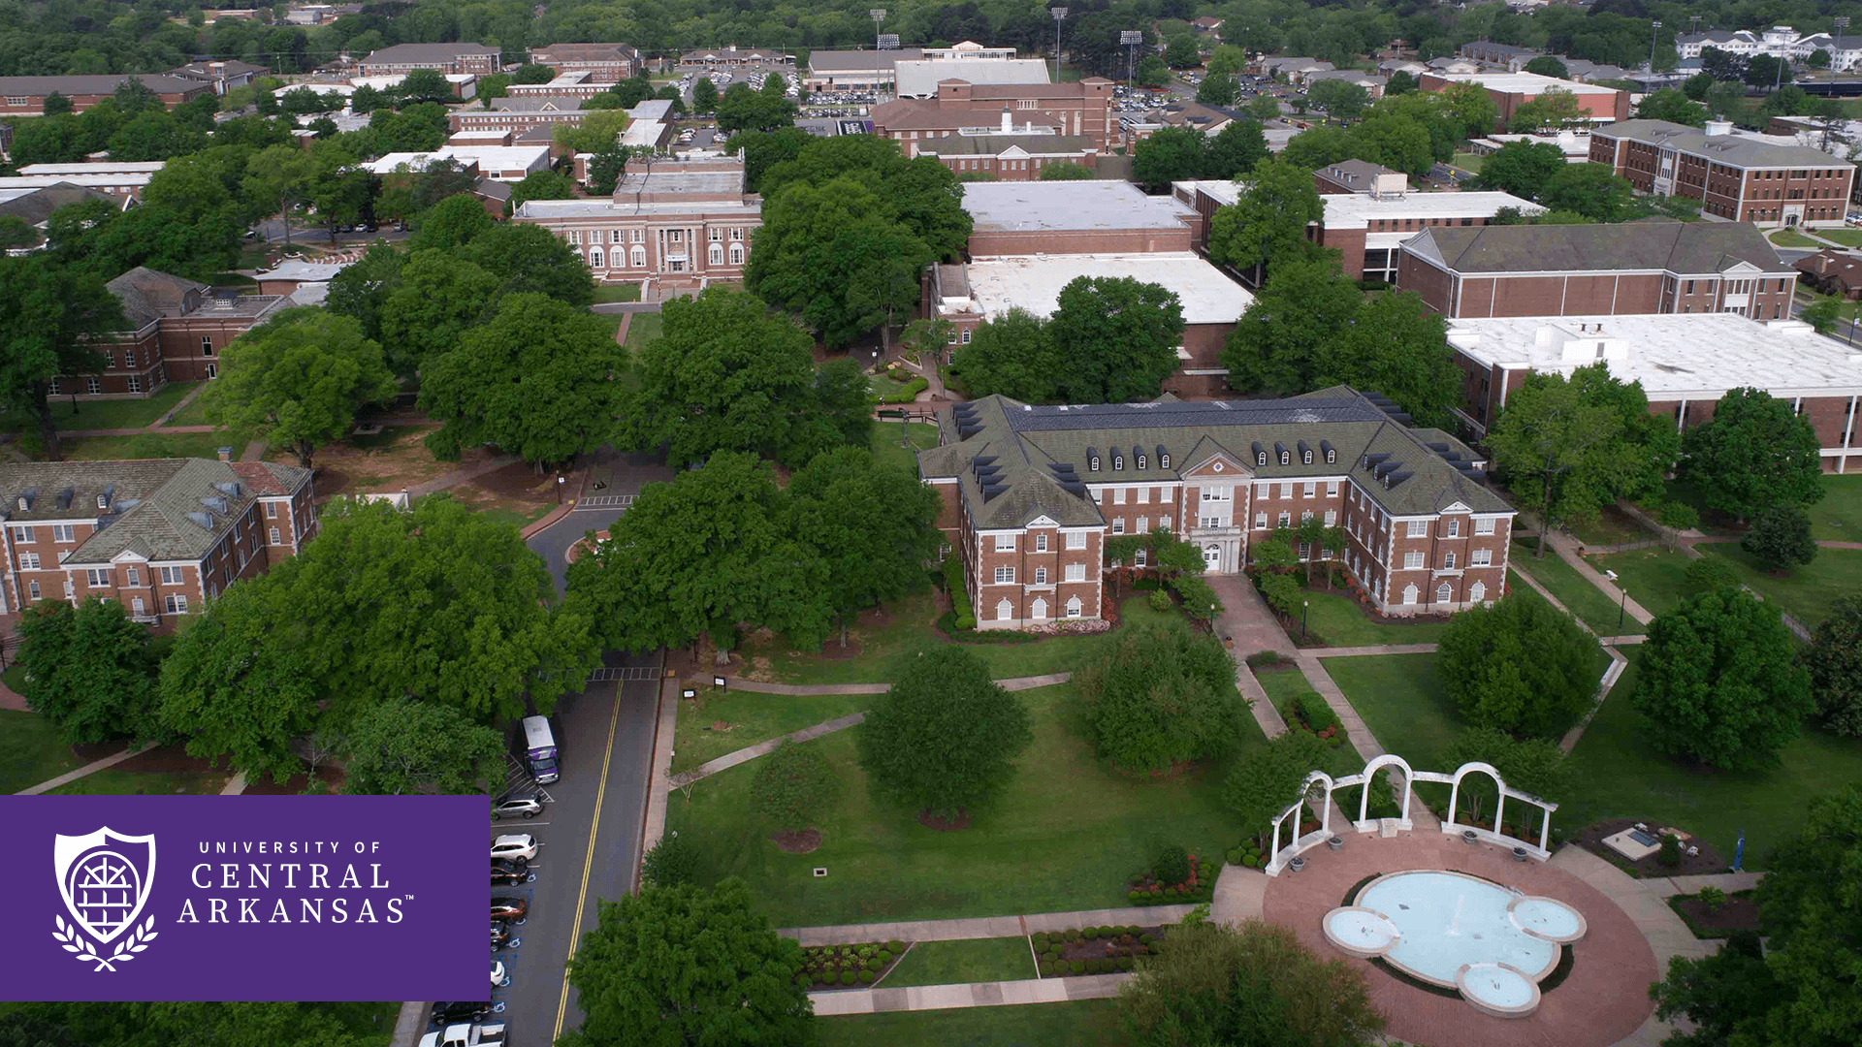
Dr. Houston Davis, President
University of Central Arkansas

Slide 4
UCA Update to ADHE and
Outlook for Fall 2024 and Beyond
*****************************
President Houston Davis, July 26, 2024

Slide 5
In Addition to “Welcome” -- Two Goals
Reminder of our conversations during ADHE’s last visit in July 2019 about our biggest plans and how they (especially our ROI initiative) expanded and evolved since that time.
Update on where we stand after the implementation of the UCA Commitment program – including its unique origin and construction in ROI.

Slide 6
Focused Governance
Main Objectives in Annual Budget Process
Cautious Optimism Focus on Student Success Maintain Stable Reserves
Minimize the Financial Impact to Students
Top Leadership Priorities
Focus on Enrollment & Student Success Initiatives Academic Program Improvements & Expansion Technology Refresh
Maximize Scholarship Options & Responsiveness Salary Competitiveness & Operational Efficiencies Address Rising Facility Costs & Facility Needs Fundraising to a New Level

Slide 7
Launch of ROI in Fall 2019
“[ROI] is important to ensure that UCA remains a choice university and positioned to fulfill our mission and thrive during an era of uncertainty for public and private universities and colleges.”
– UCA Convocation, August 2019

Slide 8
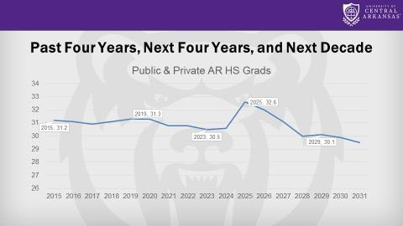
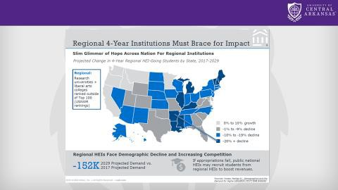
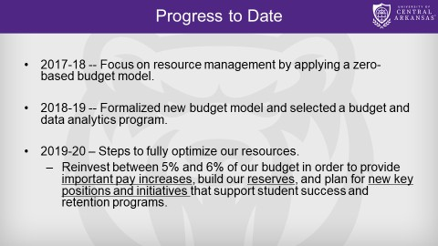
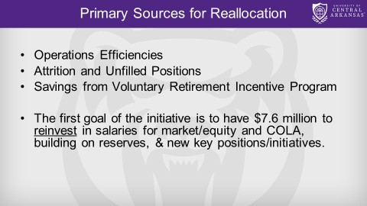
Launch of ROI in Fall 2019
Slides from multiple events in fall of 2019

Slide 9
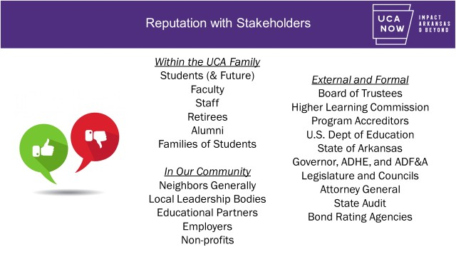
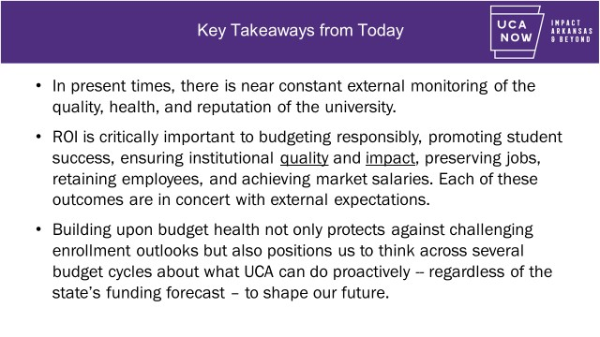
Stakeholders and ROI
Slides from November 2021 ROI Forum on Stewardship of the Public Trust

Slide 10
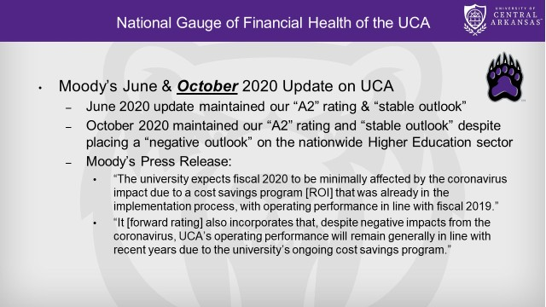
Ratings Guidance and ROI
“Fiscal 2020 operating performance was minimally affected by the coronavirus due to the CARES Act funding and a cost savings program that was already in the implementation process.”
Source: Rating Action: Moody's assigns A2 to University of Central Arkansas,
\AR's Series 2020E Student Fee
refunding bonds; outlook stable - 08 Oct 2020
Slide from October 2020 Campus Forums

Slide 11
Resource Optimization Initiative
Components of ROI 2.0 (‘23 to ‘27)
Zero Based Budgeting
Cost Evaluations for All Units
Revenue Centered Management
Market & Equity Analysis
Budget Reserve Maintenance
Voluntary Retirement Program
Temporary Hiring Freezes
Reduction in Temp & PT Positions
Purchasing Controls & Contract Reductions
Centralization of Reserves & M&O
Reorganization of Departments and Units
Maximize 1300 - 1340 FTE
Streamline Academic Programs
Cut Low Enrolled Programs

Slide 12



Key Examples from ROI
As we began the ROI work in the fall of 2019, UCA had 1,475
full-time, benefits-eligible employees.
As we start the fall of 2024, UCA has 1,320 full-time, benefits- eligible employees.
Accomplished through zero layoffs
Represents a right-sizing of the largest portion of our budget (personnel) and the most avoided task in higher education.
The difference of 155 employees represents over $12 million of budget flexibility & health.

Slide 13



Key Examples from ROI
UCA streamlined departments and units including reducing number of academic colleges from six to five and bringing all enrollment service-related units under one division.
UCA was the first public university or college in Arkansas to have zero low-enrolled programs on the Arkansas Division of Higher Education’s Low Productivity Report.
In addition to a reduction of overall positions, we are in the sixth year of regularly reassigning positions to growing academic programs.

Slide 14

Key Examples from ROI
Scholarship “right-sizing” driven by regular review of award
levels, market research, yield generation, etc.
Award level adjustments to reach maximum number of students at appropriate level of support (ex: 172% of need)
Five year process toward efficiencies & “moonshot”
EAB assistance in net tuition revenue monitoring and peer
comparisons (Wisely sell our lemonade)

Slide 15
Key Examples from ROI + UCA Commitment
Education Advisory Board (EAB) partners on our weekly monitoring of Net Tuition Revenue and Discounting and comparing against peer institutions. Current 7/24/24 analysis for 2024 shows $18.5m but does not include final UCA Commitment and Athletics scholarships. With max estimates for those factored in, EAB expects that UCA’s final number for 2024 will be between $14m to $15m.
Net Tuition Rev (in millions)
16.0
14.5
14.0
12.1
11.6
11.8
12.0
11.2
11.0
10.9
10.0
8.0
6.0
4.0
2.0
0.0
2018
2019
2020
2021
2022
2023 2024
Projected

Slide 16
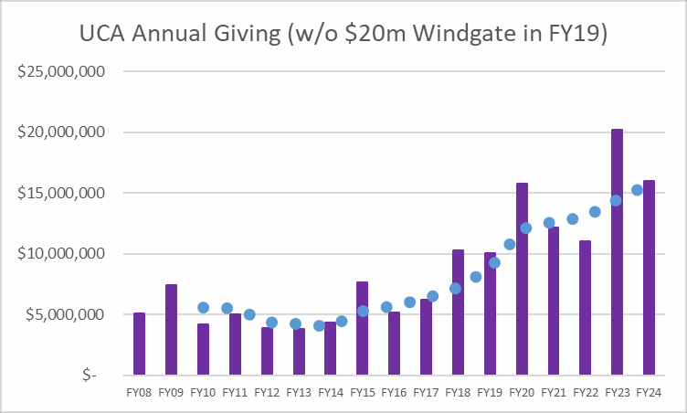
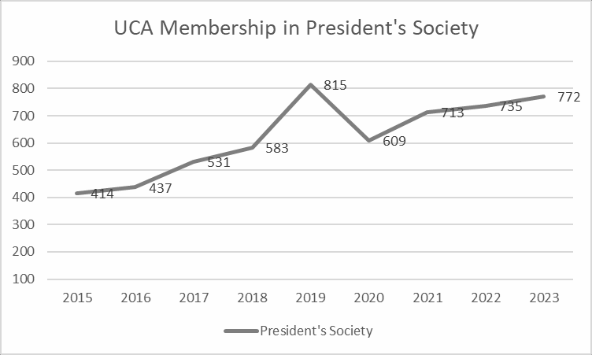
Sidebar: Fundraising Trends
The UCA Now Campaign resulted in
$122.6m in gifts, and the campaign goal of
$100m was exceed one year ahead of time.
Annual giving has surpassed $10m for seven
consecutive years.
The UCA Now Campaign had over 19,653 unique donors make contributions to their university.
Key indicators like President’s Society membership ($1k & up households) have continued their upward trajectory.

Slide 17
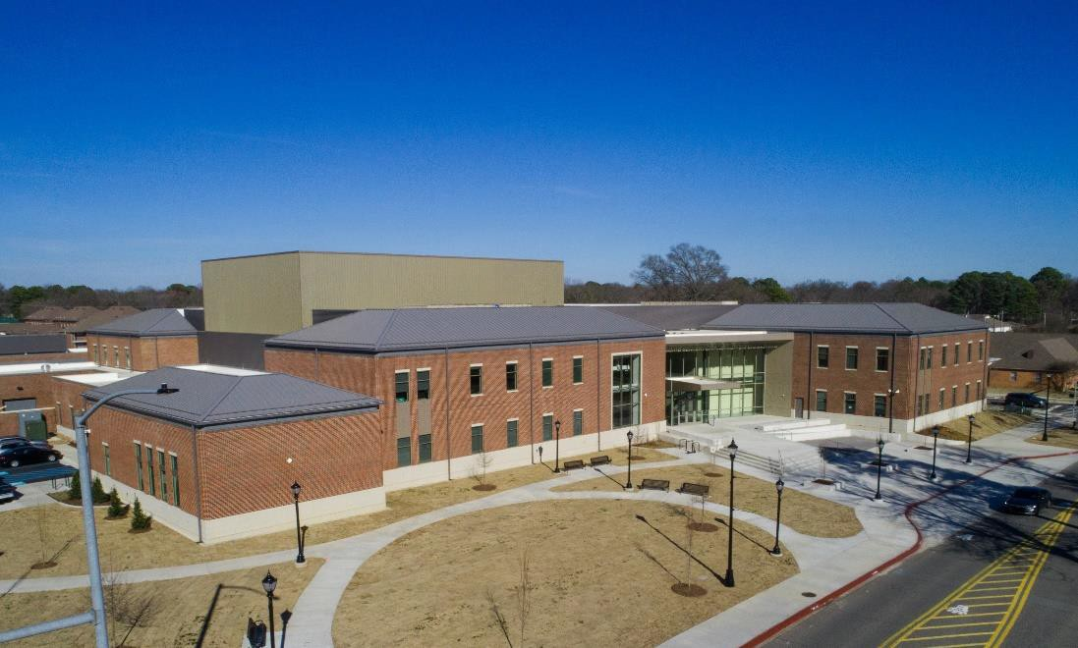

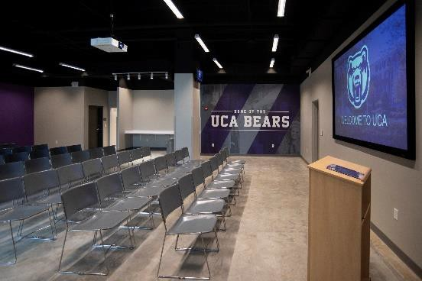
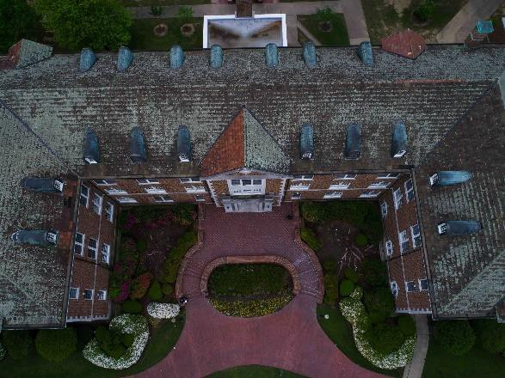


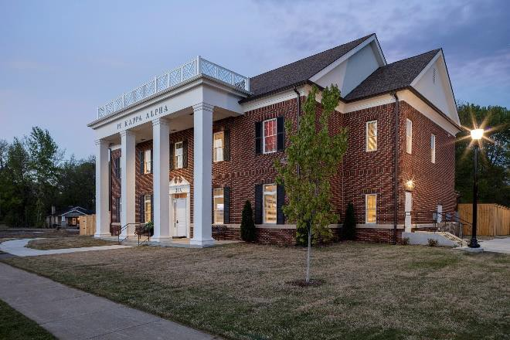
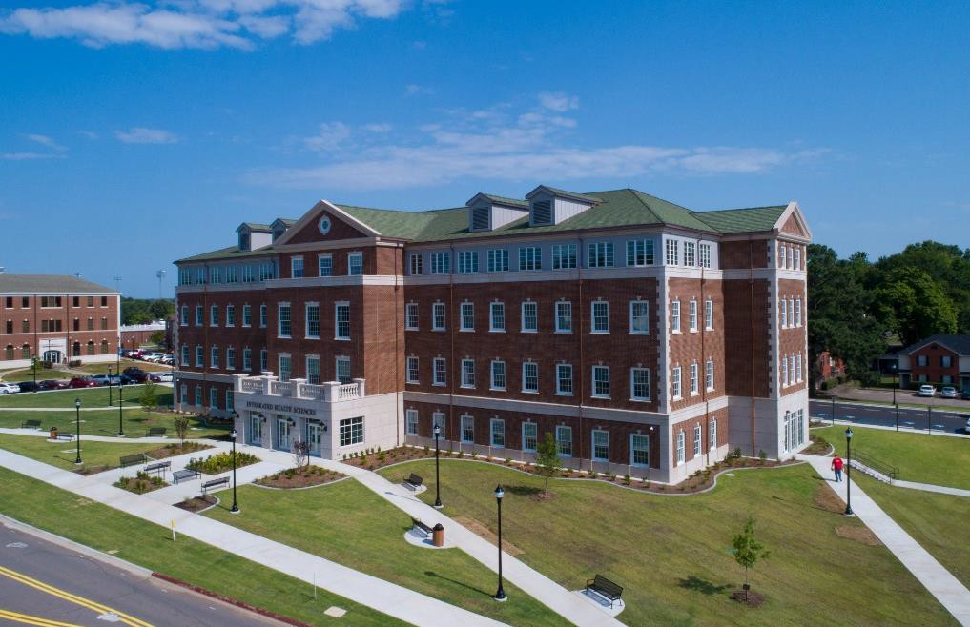
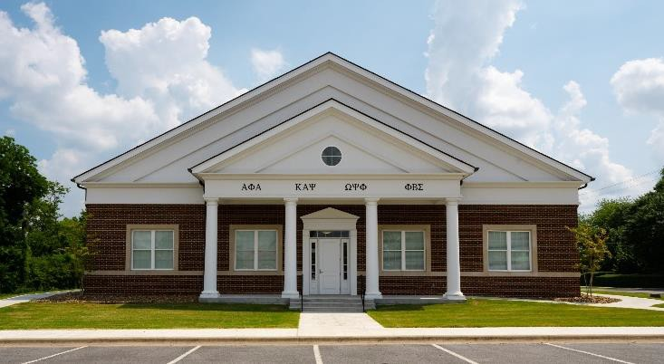
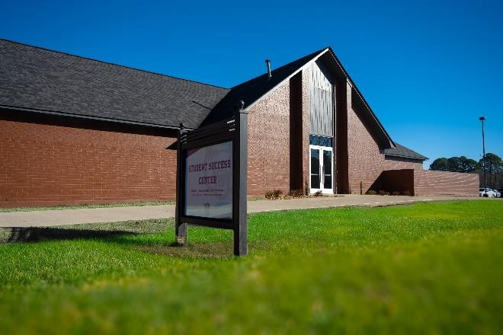
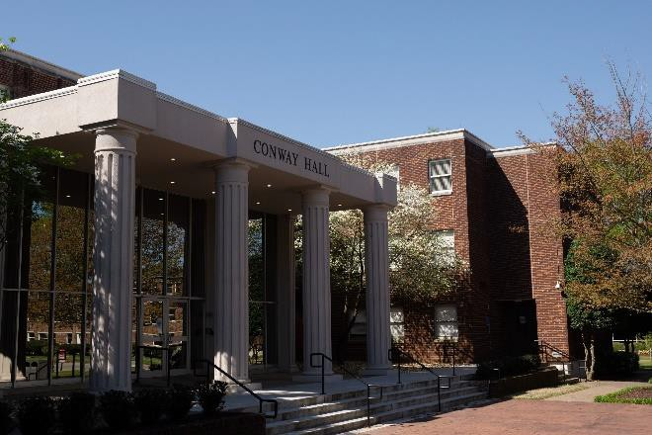
Sidebar: Strategic Decisions on Facilities
+10
+2
+3

Slide 18

Launching the UCA Commitment
********
Providing National Leadership at a Crucial Time in Higher Education

Slide 19
Central Challenge for All
At the same time that having a postsecondary degree greatly increases your earning potential and decreases your likelihood of unemployment
… higher education is facing a huge challenge because significant cost barriers – both real and perceived – are directly influencing declining participation rates.

Slide 20
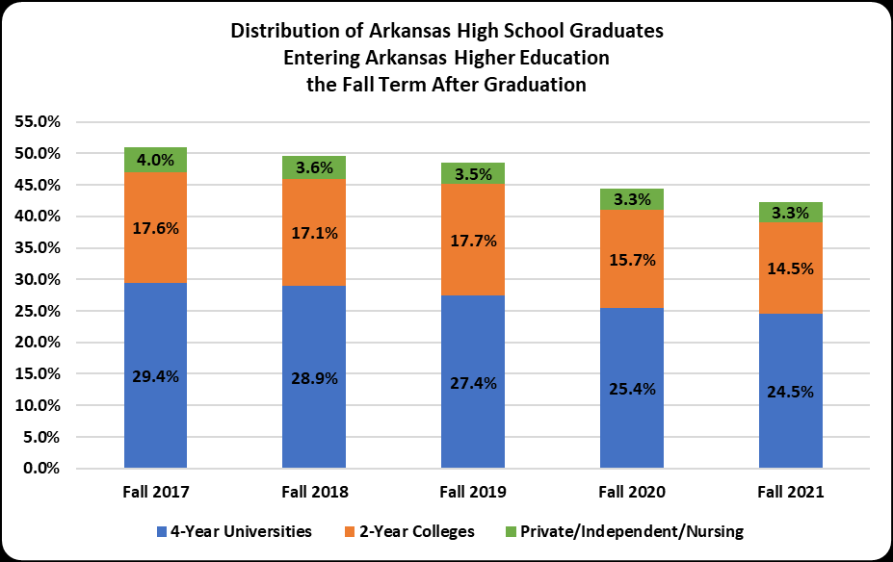
Central Challenge for All

Slide 21
The Financial Barriers
Though the average total loan debt for UCA graduates is a relatively low $22,310 (well below the national norms), families must give pause when thinking about taking on any level of debt.
The average annual unmet need - the amount owed after all federal and state aid and institutional and private scholarships – for the majority of students is just over $4,000 per year. Students turn to loans to cover that balance and, in the worst cases, are putting those balances on credit cards.

Slide 22
The Financial Barriers
The discouragement that comes when a family cannot bridge the gap of unmet need for their first year of college is made insurmountable when considering the accumulated gap in four years.
Students and families walk away assuming that a college degree is no longer attainable. To make matters worse, they are often leaving with some debt incurred but no degree in hand to show for it.
UCA has set shifting the narrative as a priority and has taken on the grand challenge of fundamentally changing how we position aid and providing national leadership in this space.

Slide 23

Our Groundbreaking Solution

Slide 24




Efficient Use of Support
Institutional Commitment via ROI
UCA will assist students through the efficient use of resources, with our leaders and stakeholders
fully backing this program’s transformative potential.
Federal & State Funding
Students must submit a completed Federal Application for Student Aid and Arkansas Academic Challenge Scholarship application to access all possible aid for this program.
Support from Alumni and Donors
Generous contributions and endowments from alumni and donors who support UCA’s mission greatly help fund the UCA Commitment and ensure its reach and continuity.
Partnerships & Collaboration
UCA will work with community organizations, businesses, and government bodies to boost the program’s impact. These collaborations offer more resources and opportunities for students’ success.

Slide 25
Financial Aid Components
Tuition and fee costs will be fully covered for eligible students through scholarship and work-study opportunities.
Last Dollar Scholarships - Cover the cost of tuition and fees after considering institutional, state, and federal financial aid.
Work-Study Opportunities - Participants with greater unmet needs may accept an on-campus job opportunity to cover remaining tuition and fee expenses.

Slide 26


Slide 27
Impact on Fall 2024 Class
As of July 24, 2024 | Fall 2024 | Fall 2023 | Change
Total Applications | 8833 | 8271 | 7%
Completed Applications | 7003 | 6576 | 6%
Admitted Students | 6268 | 5961 | 5%
Denied Students | 735 | 615 | 20%
SOAR Registrations* | 2318 | 1907 | 22%
Freshman Already Enrolled** | 1931 | 1696 | 14%
Housing Deposits | 1831 | 1486 | 23%
*The peak of SOAR registrations was 1,907 by July 31, 2023
**The peak of freshman registrations was 1,773 on Aug 17, 2023

Slide 28

Excitement for the Freshman Class

Slide 29

UCA. EDU/COMMITMENT

Slide 30
FINANCE COMMITTEE

Slide 31
Nick Fuller
Assistant Commissioner
AGENDA ITEM NO. 1:
CERTIFICATION OF BUDGETED INTERCOLLEGIATE ATHLETIC REVENUES AND EXPENDITURES FOR 2024-2025

Slide 32
Athletic Fees Per SSCH

Slide 33
Intercollegiate Athletic Budget Report for 2024-25

Slide 34
Intercollegiate Athletic Budget Report for 2024-25

Slide 35
Intercollegiate Athletic Budget Report for 2024-25

Slide 36
Intercollegiate Athletic Budget Report for 2024-25

Slide 37
Intercollegiate Athletic Budget Report for 2024-25

Slide 38
Nick Fuller
Assistant Commissioner
AGENDA ITEM NO. 2:
PRODUCTIVITY-BASED FUNDING DISTRIBUTION 2025-26

Slide 39
Productivity Funding Distribution
8th Year of Productivity Funding Model
Baseline Metrics used data from AY2020-2022 with Comparative Metrics based on AY2021-23
Overall Productivity Increase of 0.12% resulting in a recommendation of $582,686,395 to be distributed to Institutions
This leaves a balance of $5,885,292 to be utilized for Statewide Purposes as outlined in the Productivity Funding Distribution Policy

Slide 40
Productivity Funding Distribution

Slide 41
Productivity Funding Distribution

Slide 42
Productivity Funding Distribution

Slide 43
Productivity Funding Distribution

Slide 44
Productivity Funding Distribution

Slide 45
Productivity Funding Distribution

Slide 46
Productivity Funding Distribution

Slide 47
Nick Fuller
Assistant Commissioner
AGENDA ITEM NO. 3:
OPERATING RECOMMENDATIONS FOR THE 2025-26 FISCAL YEAR

Slide 48
ADHE Recommendation
Recommendations for State Operating levels are based on Productivity Funding Recommendations as well as current estimates for EETF and WF2000 funding.
Non-Formula recommendations are based on a 7.0% continuing level increase as well as any program enhancement requests submitted by the institutions after review by ADHE staff.
ADHE is recommending an additional 5% spending authority increase to the funding recommendations within the productivity model to account for any fluctuations with the forecast for special revenues that are included in the State appropriations.

Slide 49
Operating Recommendations

Slide 50
Operating Recommendations

Slide 51
Operating Recommendations

Slide 52
Operating Recommendations

Slide 53
Operating Recommendations

Slide 54
Operating Recommendations

Slide 55
Nick Fuller
Assistant Commissioner
AGENDA ITEM NO. 4:
PERSONAL SERVICES RECOMMENDATIONS FOR THE 2025-27 BIENNIUM

Slide 56
Summary of Recommendations
Line-item maximum salary increases were considered this biennium, and all line-item maximums were adjusted by 7.0 percent per year.
  Salary recommendations for new positions were based on salaries for similar positions previously established at comparable institutions.
Institutions have 27,058 positions currently authorized, excluding UAMS.
  ADHE Staff recommends an increase of 52 positions for institutions.
  INCREASE of 0.2 percent for a total of 27,110 positions
UAMS did not request to change their currently authorized position total of 11,974.
  ADHE Staff recommends continuation of the current level of 11,974 positions.

Slide 57
Nick Fuller
Assistant Commissioner
AGENDA ITEM NO. 5:
ECONOMIC FEASIBILITY OF A LOAN ISSUE FOR SOUTH ARKANSAS COLLEGE

Slide 58
Relevant Information
$4.0 million with a term of up to twenty (20) years @ a rate of approximately 7.5%
Educational and General (E&G) purposes
Revenue Funding Source: Tuition and Fee Revenue, Sales Tax Revenue

Slide 59
Relevant Information
Proceeds from the loan issue will be used for:
  Construction of a new facility to house:
    Procurement
    Maintenance
    Custodial Staff
    Shipping & Receiving

Slide 60
Nick Fuller
Assistant Commissioner
AGENDA ITEM NO. 6:
ECONOMIC FEASIBILITY OF A LOAN ISSUE FOR THE ARKANSAS STATE UNIVERSITY SYSTEM

Slide 61
Relevant Information
Update to Board Policy regarding the Interest Rate for loans issued through the College Savings Bond Revolving Loan Fund
  Current policy calculates interest for loans at the yield rate of one-year U.S. Treasury bills (as published on the third Thursday of the month preceding the State Board meeting) plus a sliding-scale margin based on the term of the loan
  ADHE Staff recommends changing this rate to a flat 0.2% to be in line with the rate for the new Sustainable Building Maintenance Revolving Loan Fund that is also administered through ADHE.

Slide 62
Relevant Information
$2.9 million with a term of ten (10) years @ an estimated rate of 0.2%
Educational and General (E&G) purposes
Revenue Funding Source: Tuition and Fee Revenue

Slide 63
Relevant Information
Proceeds from the loan issue will be used for:
      Various critical and deferred maintenance, renovation, and other miscellaneous projects across the ASU-System

Slide 64
ANY QUESTIONS?

Slide 65
ACADEMIC COMMITTEE

Slide 66
Mason Campbell
Assistant Commissioner
of Academic Affairs

Slide 67
Annual Review of Faculty Performance Report
Colleges and universities are required to conduct faculty performance reviews under Arkansas Code Annotated §6-63-104 and AHECB policy 5.5.
ADHE staff is required to monitor faculty evaluation processes adopted at Arkansas public institutions and report annually to the AHECB and Legislative Council.
Institutions conducted faculty performance reviews during 2023-2024 and plans are on file with ADHE. Institutions are required to conduct rigorous, consistently applied annual review of all faculty, using a variety of methods including assessment by students, classroom visits by administrators, peer review, and self-evaluation activities.
Executive Agenda Item No. 7

Slide 68
Annual Review of Faculty Performance Report
AY2024 Summarized Findings
Institutions continue to improve and implement assessment and evaluation software, such as Insights, Helio Campus, Watermark, and Mentor.
Several institutions specifically mentioned focused improvements in online course development and faculty support.
Observation forms and assessment tools are being discussed, evaluated, and updated at multiple institutions.
The faculty peer review components are being strengthened and modernized at many institutions.
One institution mentioned improving professional development specifically for skills in teaching and instruction for industry experts who teach workforce/occupational courses.
Executive Agenda Item No. 7

Slide 69
Questions?

Slide 70
Academic Program Review Policy
Arkansas Code §6-61-214 requires that the AHECB review existing academic programs at Arkansas public colleges and universities.
The goals of the existing academic program review are as follows:
  To establish a process for the statewide review of academic programs.
  To identify certificate and degree programs not meeting minimum standards of quality and to establish schedules for either resolving these concerns or removing the programs from the AHECB approved program inventory.
Executive Agenda Item No. 8

Slide 71
Existing Academic Program Review Process
All certificate and degree programs offered by public colleges and universities in Arkansas will be reviewed through the Existing Academic Program Review Process.
This review process includes the following parameters:
All academic programs will be externally reviewed every 7-10 years. Each institution will submit its recommended program review cycle to ADHE. If changes in the review schedule are necessary, ADHE will be notified.
Academic programs which are not program-specific accredited will be reviewed by external reviewers/consultants.
At least one consultant is required to conduct a site visit and meet with program faculty, students, and administrators.
The institution will complete a comprehensive self-study that is reviewed by the program consultants.
Executive Agenda Item No. 8

Slide 72
Academic Program Review
Self-Study Components
The institution will complete a comprehensive self-study that is reviewed by the program consultants. Components of the self-study
will include, but not be limited to, information related to:
  program need/demand,
  curriculum,
  faculty,
  resources,
  course delivery methods,
  student outcomes, and
  recent/planned program improvements
Executive Agenda Item No. 8

Slide 73
Summation of AY2024
Institutional Academic Program Reviews
Inst. | # of Reviews Received |  | Inst. | # of Reviews Received |  | Inst. | # of Reviews Received |  | Inst. | # of Reviews Received
ANC | 1 |  | CCCUA | 0 |  | SAUM | 5 |  | UAM | 4
ASUB | 20 |  | EACC | 0 |  | SAUT | 1 |  | UAMS | 0
ASUJ | 9 |  | HSU | 2 |  | SEARK | 4 |  | UAPB | 0
ASUMH | 13 |  | NAC | 0 |  | UACCB | 3 |  | UAPTC | 10
ASUMS | 1 |  | NPC | 0 |  | UACCHT | 0 |  | UARM | 0
ASUN | 1 |  | NWACC | 8 |  | UACCM | 9 |  | UCA | 2
ASUTR | 0 |  | OZC | 0 |  | UAF | 9
ATU | 2 |  | PCCUA | 6 |  | UAFS | 0
BRTC | 3 |  | SAC | 0 |  | UALR | 4
Executive Agenda Item No. 8

Slide 74
Academic Program Review AY2024 Update
Considerations
Takeaways
AHECB Reporting Timeline Adjustment
Impending ADHE Policy Modification
Institutions are improving their program review processes, such as:
  Cognate embedding similar/like programs
  Program removal due to Program Viability
Executive Agenda Item No. 8

Slide 75
Questions

Slide 76
Tracy Harrell
Chief Program Development Officer
Academic Affairs

Slide 77
Arkansas Public Letters of Notification
24 Arkansas public institutions submitted Letters of Notification
affecting 147 unique programs of study
Received by May 1, 2024
n | Requested Action
2 | Articulation Agreement
7 | CIP Code Change of Existing Program
37 | Curriculum Revision
8 | Deletion of Option, Concentration, Emphasis, or Minor
14 | Existing Program Offered Via Distance Education
21 | New Certificate
21 | New Option, Concentration, Emphasis, or Minor
20 | Program Deletion
15 | Program Inactivation
12 | Program Reconfiguration
2 | Reorganization of Existing Organizational Unit
1 | Title Change of Existing Option, Concentration, Emphasis, or Minor
10 | Title Change of Existing Organizational Unit
16 | Title Change of Existing Program
186
Academic Affairs Agenda Item No. 9

Slide 78
Arkansas Public Letters of Intent
2 Arkansas public institutions submitted Letters of Intent
Received by July 1, 2024
n | Reason of Intent
1 | New Off-Site Instruction Center
1 | New Program
2
Academic Affairs Agenda Item No. 10

Slide 79
Alana Colburn
Associate Director of
Private Postsecondary Education

Slide 80
Out-of-State and Arkansas Private Institutions
Letters of Notification
​
4 Out-of-State Institutions submitted Letters of Notification for minor changes in authorized programs​
1 Arkansas Private Institution is changing location
Academic Affairs Agenda Item No. #11

Slide 81
Out-of-State and Arkansas Private Institutions
Letters of Intent
21 Out-of-State Institutions submitted Letters of Intent​
​
Academic Affairs Agenda Item No. #12

Slide 82
REGULAR MEETING OF THE
ARKANSAS HIGHER EDUCATION
COORDINATING BOARD
July 26, 2024

Slide 83
Approval of Minutes
April 26 Regular Meeting
May 29,Special Meeting

Slide 84
Dr. Ken Warden
Commissioner
AGENDA ITEM NO. 14:
COMMISSIONER’S REPORT

Slide 85
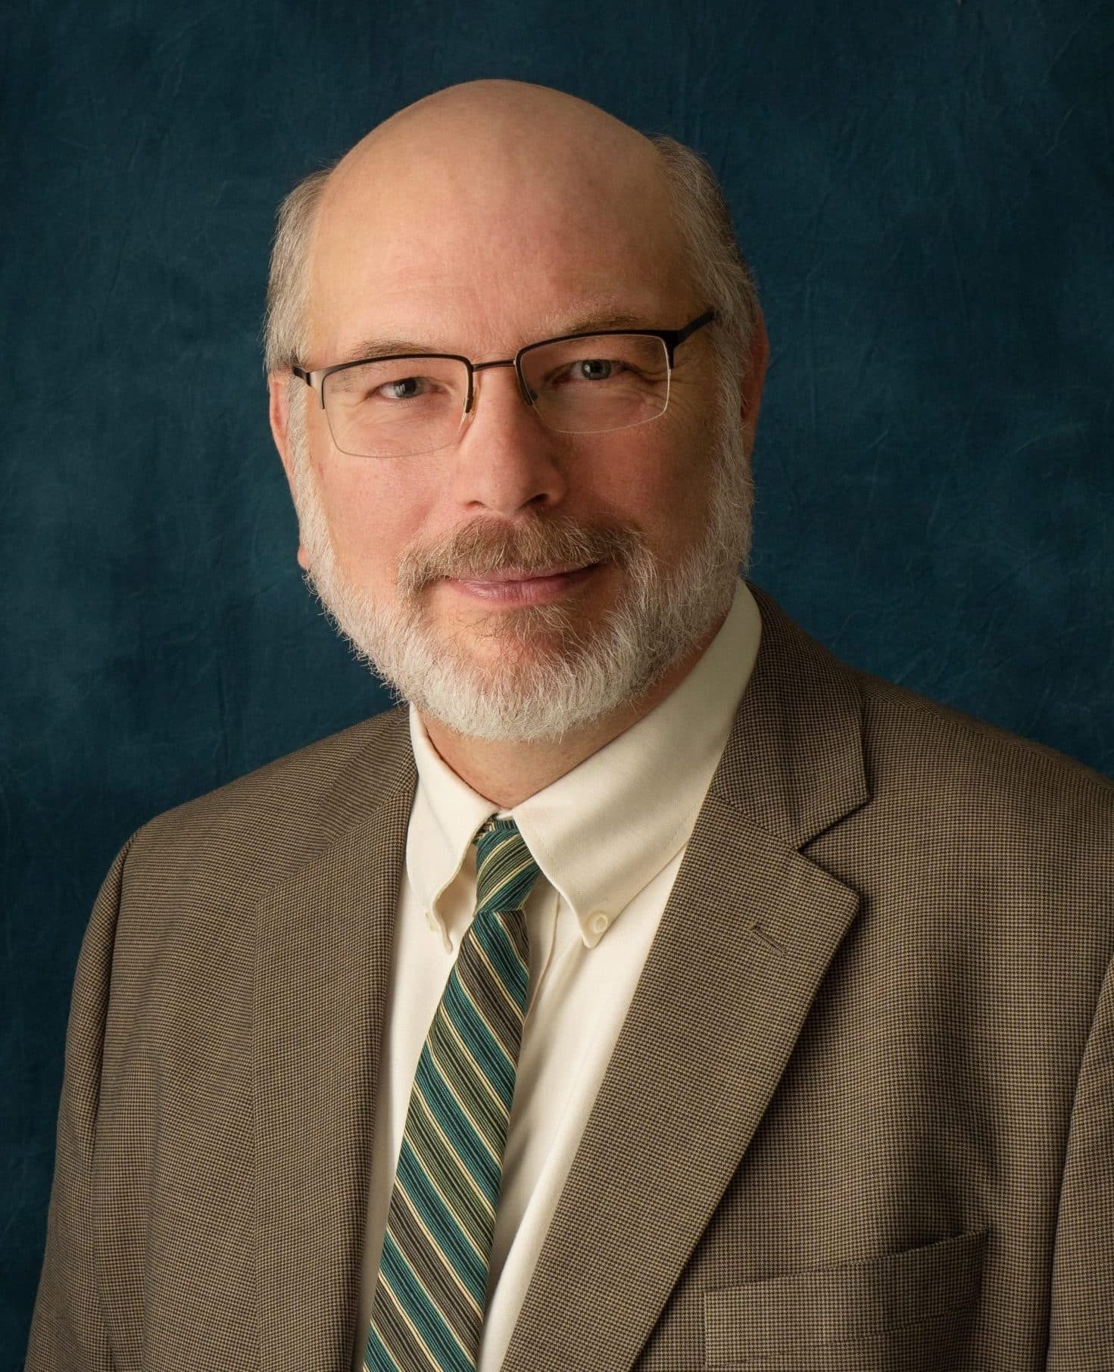
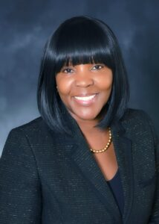
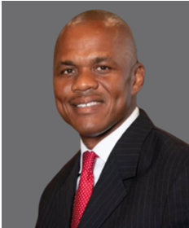

Institutional Changes
Dr. Bruno Hicks
President
Southern Arkansas University
(effective June 17, 2024)
Dr. Andrea Stewart
Interim Chancellor
University of Arkansas at Pine Bluff
(effective July 1, 2024)
Dr. Tyrone Jackson
President
Southeast Arkansas College
(effective July 1, 2024)
Dr. Stephanie Tully-Dartez
President
South Arkansas College
(effective July 1, 2024)

Slide 86



Slide 87
IT COLLECTION OF
NON-CREDIT WORKFORCE
EDUCATION AND TRAINING

Slide 88
HIRED GRANTS

Slide 89

STANDARDIZING AI IN ARKANSAS HIGHER EDUCATION

Slide 90
ANY QUESTIONS?

Slide 91
Mason Campbell
Assistant Commissioner of Academic Affairs
AGENDA ITEM NO. 15:
CONCURRENT ENROLLMENT POLICY UPDATE

Slide 92
CONCURRENT ENROLLMENT POLICY UPDATE
Minor Changes:
  Language cleanup (organizational structure and titles)
  Reporting dates and terminology
  Removal of funding references
Major Changes:
  Updated concurrent enrollment course placement to allow for multiple measures assessment (MMA)
Rationale for Policy Update:
  ADHE research with Center for the Assessment of Postsecondary Readiness (CAPR)
2024 Arkansas Concurrent Enrollment Stakeholder Report and Recommendations
  Institutional requests/support for multiple measures

Slide 93
ANY QUESTIONS?

Slide 94
Agenda Item No. 16
Policy Amendment: Arkansas Teacher Academy Scholarship Program
Amendments as a result of Act 237 of 2023
No known opposition
No anticipated fiscal impact

Slide 95
Agenda Item No. 17
Policy Amendment: Concurrent Challenge Scholarship Program
Amendments as a result of Acts 413, 386, and 539 of 2023
No known opposition
No anticipated fiscal impact
Substantive changes include:
  Addition of high school sophomore eligibility
  Removal and clarification of vocational technical schools
  Addition of language regarding summer semester eligibility

Slide 96
Agenda Item No. 18
Policy Amendment: Arkansas Future Grant Program
Amendments as a result of Act 413 of 2023
No known opposition
No anticipated fiscal impact
Substantive changes include:
  Removal and clarification of eligibility program requirements
  Addition of language regarding summer semester eligibility

Slide 97
Agenda Item No. 19
Policy Amendment: Governor’s Scholars Program
Amendments as a result of Acts 413 of 2023
No known opposition
No anticipated fiscal impact
Substantive changes include:
  Addition of language regarding summer semester eligibility

Slide 98
Agenda Item No. 20
Policy Amendment: Arkansas Workforce Challenge Scholarship Program
Amendments as a result of Acts 413 and 539 of 2023
No known opposition
No anticipated fiscal impact
Substantive changes include:
  Addition of vocational technical schools
  Addition of language regarding summer semester eligibility

Slide 99
Agenda Item No. 21
Policy Amendment: Governor’s Higher Education Transition Scholarship Program
Amendments as a result of Act 413 of 2023
No known opposition
No anticipated fiscal impact
Substantive changes include:
  Removal and clarification of eligibility program requirements
  Addition of language regarding summer semester eligibility

Slide 100
Agenda Item No. 22
Policy Amendment: Productivity Funding Distribution Policy
Amendment due to recommendation from Funding Workgroup
No known opposition
No additional fiscal impact
Policy amendment changed the stop-loss within the model from 5% of the FY2018 base funding to 5% less than the base funding from 5 years prior to the distribution year.

Slide 101
Agenda Item No. 23
Policy Amendment: Sustainable Building Maintenance Revolving Loan Fund Rules
Rules drafted as a result of Act 751 of 2023
No known opposition
For FY2025, the fund will receive $4.5M in state general revenue funding to begin offering loans.
Low interest loans are offered to state-supported institutions of higher education for the purpose of funding deferred or critical maintenance, or the renovation of state-owned property. These loans will be repaid by the borrowing institutions into a Revolving Loan Repayment Fund that will provide funds for subsequent loans to state supported institutions.
Interest on loans will be set at 0.2% to cover overhead costs of ADHE in administering the program.

Slide 102
Agenda Item No. 24
Policy Amendment: Military Dependents Scholarship
In compliance with Act 413 of 2023
No known opposition
No anticipated fiscal impact
Substantive changes include:
  Addition of new category of dependents and define the eligibility of stepchildren
  Clean up language

Slide 103
Agenda Item No. 25
Policy Amendment: Financial Aid
Appeals Process
In compliance with Act 244 of 2023
No known opposition
No anticipated fiscal impact
Substantive changes include:
  Increase of loan repayment from $3,000 and in some cases $4,000 to all $6,000 each year for three years

Slide 104
Agenda Item No. 26
Policy Amendment: State Teacher Education Program
In compliance with Act 237 of 2023
No known opposition
No anticipated fiscal impact
Substantive language includes:
  Creation of the Appeals Committee
  Criteria for student appeals

Slide 105
Agenda Item No. 27
Policy Amendment: Teacher Opportunity Program
In compliance with Act 413 of 2023
No known opposition
No anticipated fiscal impact
Substantive changes include:
  Clarity on the definition of semesters
  Clarity for student eligibility earning a pass/fail for dissertation coursework

Slide 106
Agenda Item No. 28
Policy Amendment: The Washington Center Scholarship
In compliance with Act 413 of 2023
No known opposition
No anticipated fiscal impact
Substantive change include:
  Clarity on the definition of semesters

Slide 107
Agenda Item No. 29
Policy Amendment: Law Enforcement Dependent's Scholarship Program
In compliance with Act 413 of 2023
No known opposition
No anticipated fiscal impact
Substantive changes include:
  Clarity on the definition of semesters

Slide 108
ANY QUESTIONS?

Slide 109
FINANCE COMMITTEE REPORT

Slide 110
ACADEMIC COMMITTEE REPORT

Slide 111
PUBLIC COMMENTS/
ANNOUNCEMENTS
Follow-up questions can be sent to: Nichole.Abernathy@adhe.edu
Presentations will be posted on the ADHE website at:
https://www.adhe.edu/about-adhe/coordinating-board/board-presentations

